Slide 2
Margo O’Donnell, Co-Chair and Partner, Labor and Employment, Benesch Friedlander Coplan & Aronoff LLP
Stephanie Penninger, Senior Director, Legal Counsel, RXO, Inc.
T. Christine Pham, Associate General Counsel, Cowan Systems, LLC
Beata Shapiro, Partner, Wilson Elser LLP

Slide 3
Agenda
What are Microaggressions
Incidence and Prevalence
Applicable law and attorney ethics issues
Impact on management of employees in companies and in law firms
Business
Legal Liability
Strategies to Address and Combat Microaggressions in Compliance with applicable law, including Mansfield certification

Slide 4
General Definition
Microaggressions can be defined as brief and commonplace verbal or nonverbal insults or slights, intentional or unintentional, which communicate hostile, derogatory or negative messages based on a person’s characteristics.
(Nadal, Griffin, Wong, Hamit, and Rasmus, 2014)

Slide 5
Targets of Microaggressions
Microaggressions often target characteristics protected under federal and state law such as:
Gender
Race
National Origin
Sexual Orientation
Religion
Disability/Ability
Age

Slide 6
Categories
Microinsults:
Verbal or nonverbal acts or statements that demonstrate a lack of sensitivity or respect for someone’s particular identifying characteristics.
Microassaults:
More explicit conduct that is demeaning based on personal and/or protected characteristics
Microinvalidations:
Comments or actions that negate, undermine or exclude the thoughts, experiences, or feelings of others.

Slide 7
Examples of Microinsults
Asking someone where they are from
Telling someone they speak English well
Asking a woman to bring everyone coffee
Not consulting someone who should be consulted on a business decision
Assuming that someone disabled is unable to perform a task

Slide 8
Examples of Microassault
Overtly discriminating in the workplace based on protected characteristic
Refusing to allow individuals with protected characteristics access to training or certain beneficial terms or conditions of employment
Making overtly racist, sexist comments

Slide 9
Examples of Microinvalidation
Telling someone that they are overreacting to a discriminatory comment or action
Excluding certain individuals from a company social event
Dismissing concerns about company policies

Slide 10
Polling Question
Have you felt that you were the target of a microaggression at work?
Yes
No
Not sure

Slide 11
Why does it matter?
“A lot of microaggressions when isolated can seem like they are not a big deal. That is a common misconception from those who are typically not experiencing them. These microaggressions are like mosquito bites, they may seem small and annoying but, as they pile up they have a greater effect on the person experiencing them.”
“Microaggressions In Sports: The NFL Needs To Do Better”, David Heilman, February 20, 2022

Slide 12
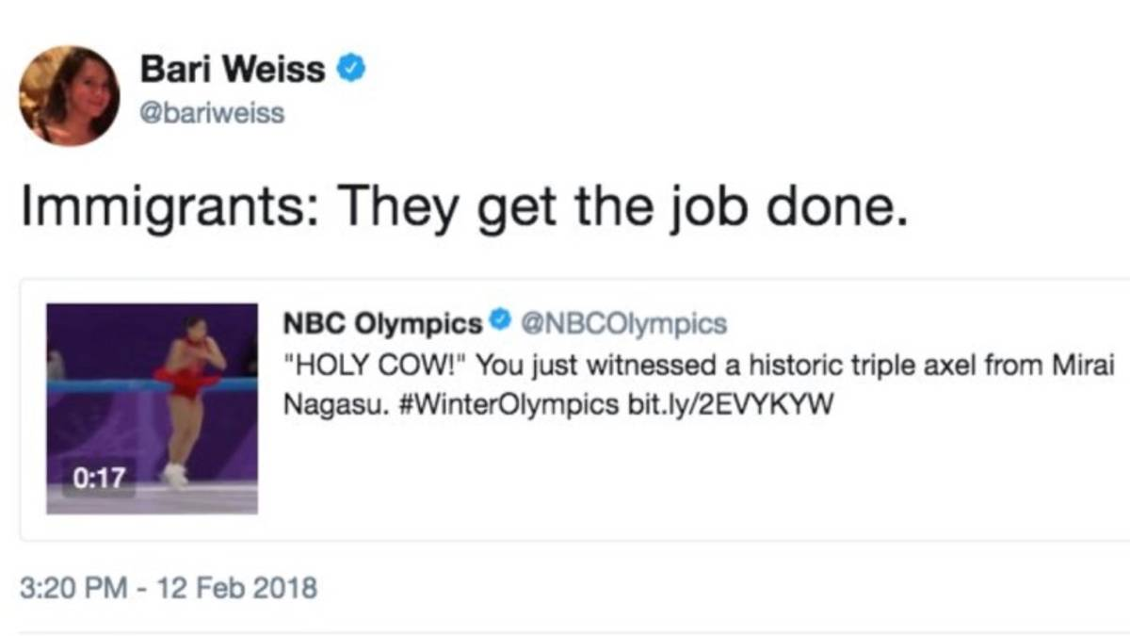
Mirai Nagasu, born in California, was competing in the 2018 Olympics
Bari Weiss is the founder of Free Press

Slide 13
Polling Question
Have you witnessed microaggressions at work?
Yes
No
Not sure

Slide 14
Microaggressions are more widespread than you may think.
According to a survey of 4,275 participants done in April 2019 by SurveyMonkey and Fortune magazine, seven in ten workers said disrespectful behavior such as microaggressions will make them consider leaving their job.
Experts estimate that losing a skilled employee costs a company roughly 33% of their annual salary.

Slide 15
Polling Question
Have you experienced or witnessed gender-based microaggressions at work?
A. Yes
B. No
C. Not sure

Slide 16
Harmful effects of Microaggressions Which of your identities were put down with a microaggression? Survey dates: 4/2/19–4/5/2019 (Survey Monkey and Fortune magazine)
Which of your identities were put down with a microaggression? (Select all that apply)
Question wording: Which of your identities were put down with a microaggression? (Select all that apply)
Survey dates: 4/2/2019–4/5/2019
 |  | Gender
Answer | Total | Male | Female
Unweighted N | 1,239 | 476 | 763
Gender | 35% | 21% | 48%
Age | 33% | 30% | 35%
Physical appearance | 31% | 33% | 30%
Race | 30% | 37% | 23%
Education | 22% | 25% | 20%
Socioeconomic status | 15% | 18% | 12%
Religion | 15% | 21% | 10%
Sexual orientation | 13% | 18% | 8%
Disability | 8% | 10% | 7%
Veteran status | 5% | 8% | 2%
Other (please specify) | 13% | 12% | 14%
No answer | 8% | 8% | 7%

Slide 17
Harmful effects of Microaggressions
Have you personally witnessed a microaggression in the workplace?
Survey: 4/2/2019–4/5/2019 (Survey Monkey and Fortune magazine)
 |  | Gender
Answer | Total | Male | Female
Unweighted N | 4,274 | 1,971 | 2,303
Yes | 36% | 34% | 38%
No | 39% | 40% | 38%
Not sure | 24% | 25% | 22%
No answer | 2% | 2% | 2%

Slide 18
Polling Question
Are microaggressions a serious workplace problem?
Yes
No
Not sure

Slide 19
Microaggressions in the Workplace
68% of Americans say microaggressions are a serious workplace problem.
36% of Americans have witnessed microaggressions at work.
26% of Americans have experienced microaggressions at work.
64% of women have experienced gender-based microaggressions at work.
February 21, 2023 https://www.zippia.com/employer/workplace-microaggression-statistics/

Slide 20
Studies find that microaggressions are grossly underreported, particularly by victims of microaggressions, with only 30% of microaggressions being reported.
Microaggressions in the workplace can negatively affect employees' job satisfaction, eventually driving them to quit.
In 2021, roughly 35 percent of U.S. workers who left a job cited feelings of disrespect as a main reason they quit, according to Pew Research Center.

Slide 21
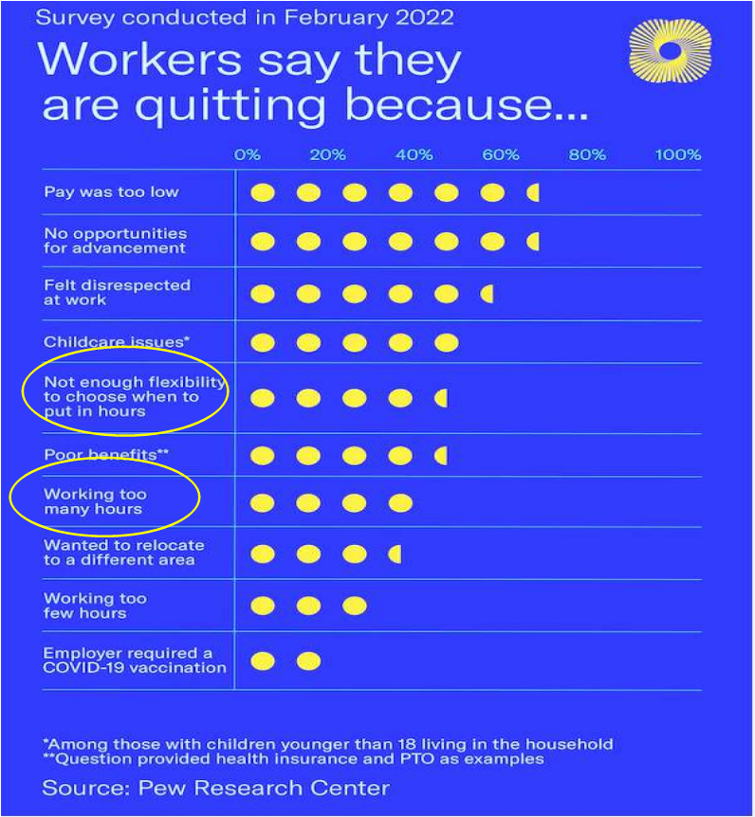
In 2022, disrespectful behavior was found to have a greater impact on losing workers than lack of flexibility and workload.

Slide 22
Costs of Microaggressions in the Workplace
Potential Costs of Microaggressions
Microaggressions can also have real financial costs on employers who ignore them. For example, they can lead to:
Lost productivity. The "soft bigotry" of microaggressions has real costs -- $450 to $550 billion in U.S. workforce productivity according to Gallup.
Low morale. It's that thing that keeps people from working just hard enough not to get fired, and all the transparency in the world won't save employees from fleeing a toxic office environment.
Claims of a hostile work environment. In some cases, microaggresions can add up to a big employment discrimination lawsuit by contributing to a hostile work environment.
Lost productivity: $450 to $550 billion in U.S. workforce productivity according to Gallup.
Low morale: Quiet quitting, less effective team interactions, leaving workers.
Legal liability: Claims of a hostile work environment or discrimination.

Slide 23
Harmful effects of Microaggressions
Have you experienced a microaggression against yourself in the workplace?
Survey dates: 4/2/2019–4/5/2019 (Survey Monkey and Fortune magazine)
 |  | Gender
Answer | Total | Male | Female
Unweighted N | 4,274 | 1,971 | 2,303
Yes | 26% | 23% | 29%
No | 51% | 52% | 49%
Not sure | 22% | 23% | 20%
No answer | 2% | 2% | 3%

Slide 24
Microaggressions and Transportation
Are microaggressions affecting the transportation industry
Should businesses proactively address microaggressions
Strategies: can awareness of the issue be used to enhance business
Sales
Recruiting
Engagement

Slide 25
Legal Issues Arising from Microaggressions
ABA Model Rule 8 – It is professional midsconduct for a lawyer to engage in conduct that a lawyer knows or reasonably should know is harassment or discrimination on the basis of race, sex, religion, national origin, ethnicity, disability, age, sexual orientation, gender identity, marital status or socioeconomic status in conduct related to the practice of law.

Slide 26
Legal Issues Arising from Microaggressions
Title VII of the Civil Rights Act of 1964, prohibits discrimination in employment on the basis of sex, race, color, national origin, and religion, and it applies to employers with 15 or more employees.
State laws such as the Illinois Human Rights Act provide similar protections

Slide 27
Under all of these laws: Intention doesn’t matter
Notes:
Notes:
Names - one study found that candidates with foreign-sounding names were 28% less likely to be called into an interview than candidates with “Anglo” sounding names, like John Smith and Julie Thomas.
Halo effect: In the 1920s, psychologist Edward Thorndike found that people who think highly of an individual in a certain way are likely to think highly of them in several other ways. For example, if we think someone is good looking, we’ll probably also think they are intelligent and charismatic. Thorndike described this as the “halo effect.” Managers need to be wary of generalizing an employee’s performance based on one specific characteristic of their personality or appearance.
The similarity bias: Companies often prefer hiring candidates who’ve worked at specific companies or schools. For example, Silicon Valley tech companies are most likely to hire candidates who went to UC Berkeley.
Gender bias: At the office, an assertive woman might be perceived as “aggressive” while a man with the same attributes might be described as “confident.” This is an example of gender bias, which is more prevalent than many might want to admit.
Confirmation bias: Thanks to confirmation bias, once we make a decision or opinion about something, we tend to look for information that confirms our beliefs and overlook information that goes against them.
“Bropropriating.” In a group meeting, a female member of the team makes a point that no one seems to feel too strongly about. Thirty minutes later, a male member of the team makes the same point—and everyone jumps on board with “his” idea. Companies that allow this kind of behavior to exist at the workplace will discourage women from sharing their ideas.
Here you may want to break down the actual word, and demonstrate that it’s an amalgamation, essentially a cousin of mansplaining. Opportunity for humor here; basically this is what would happen if mansplaining and broscience has a baby.
Height discrimination: Companies tend to promote tall people, particularly men, into senior roles; in fact, the average male CEO is three inches taller than the average male.
*Even among these examples, it’s clear that some biases are much more covert than others, E.g. the halo effect. This is not a bias someone could uncover through basic self reflection. Much less obvious and blatantly problematic than the overtly racist preference for certain names.

Slide 28
Supreme Court Authority
Wal-Mart Stores, Inc. v. Dukes, 564 U.S. 338 (2011)
Class action involving a class of 1.5 million
Plaintiffs argued that the subjective nature of Wal-Mart’s personnel policies “permit[ed] bias against women to infect, perhaps subconsciously, the discretionary decisionmaking” of Wal-Mart’s managers.
Supreme Court rejected plaintiffs’ expert testimony, holding that the testimony would not shed light on the role that implicit bias may have had on the employment decisions at issue in the case.

Slide 29
EEOC guidance
The EEOC has defined discrimination to include:
“unconscious stereotypes regarding the abilities, traits or performance of individuals belonging to certain racial groups.”

Slide 30
Illinois Supreme Court Commission on Professionalism
Found at: https://www.2civility.org/wp-content/uploads/Strategies-to-Interrupt-Bias.pdf.

Slide 31
Training Can Bolster a Defense
Training may be used as part of a defense to claims of employment discrimination based on microaggressions and bias
Yeargans v. City of Kansas City, Missouri, 2019 WL 4247837, at *15 (W.D. Mo. Sept. 6, 2019) (considering evidence in granting summary judgment that defendant's employees were trained every two to three years on discrimination, harassment, and implicit bias in matter where plaintiff alleged superiors graded promotional test in a biased manner)

Slide 32
Mansfield Certification – strategy for law firms
Based on the “Rooney” rule from football
Requirements involve considering a slate of a certain percentage of women and people of color for leadership roles and particular positions in law firms
Knowledge sharing
Group of law firms act as role models for others

Slide 33
Steps to take to reduce bias and microaggressions in the workplace
Omit the guilt
Review and change internal policies
Raise awareness and understanding
Talk about issues and take action

Slide 34
Other Considerations
Training – required by certain state law
HR Audit – Job descriptions appropriately to avoid microinsults
Proper procedures for interactive process for disability, pregnancy
Proper procedures in place for leaves

Slide 35
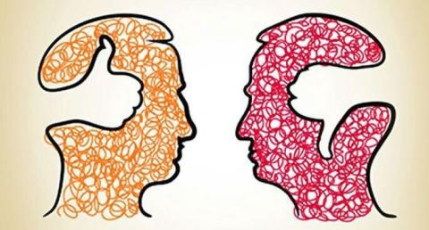
How to challenge stereotyping and implicit bias in everyday life
Top five friends
Last five friends you called
Your neighbors
Authors of last books you have read

